Slide 1
CSE 161 – Design and Architecture of Computer Systems
The Processor
A - Single & Multi-Cycle Designs

Slide 2
The Processor: Datapath & Control
MIPS implementation, simplified to only:
memory-reference instructions: lw, sw
arithmetic-logical instructions: add, sub, and, or, slt
control flow instructions: beq, j
Generic Implementation:
use the program counter (PC) to supply instruction address
get the instruction from memory
read registers
use the instruction to decide exactly what to do
All instructions use the ALU after reading the registers Why? memory-reference? arithmetic? control flow?

Slide 3
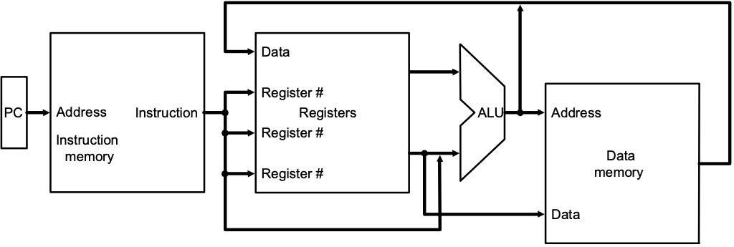
More Implementation Details
Abstract / Simplified View: Two types of functional units:
elements that operate on data values (combinational)
elements that contain state (sequential)

Slide 4
State Elements
Unclocked vs. Clocked
Clocks used in synchronous logic
when should an element that contains state be updated?
falling edge
cycle time
rising edge

Slide 5

An unclocked state element
The set-reset latch
output depends on present inputs and also on past inputs

Slide 6
Latches and Flip-flops
Output is equal to the stored value inside the element (don't need to ask for permission to look at the value)
Change of state (value) is based on the clock
Latches: whenever the inputs change, and the clock is asserted
Flip-flop: state changes only on a clock edge (edge-triggered methodology)
A clocking methodology defines when signals can be read and written
— wouldn't want to read a signal at the same time it was being written

Slide 7
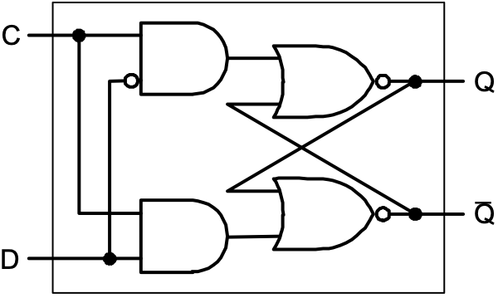
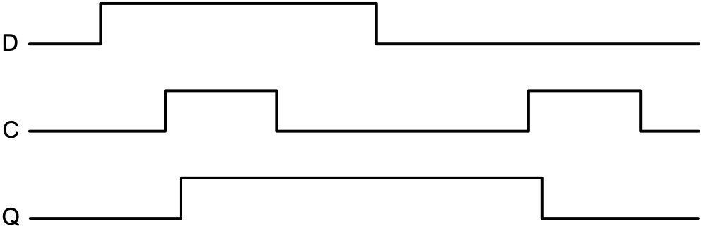
D-latch
Two inputs:
the data value to be stored (D)
the clock signal (C) indicating when to read & store D
Two outputs:
the value of the internal state (Q) and it's complement

Slide 8
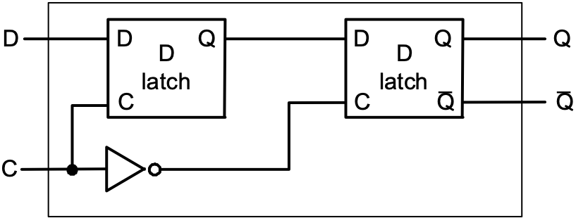

D flip-flop
Output changes only on the clock edge

Slide 9
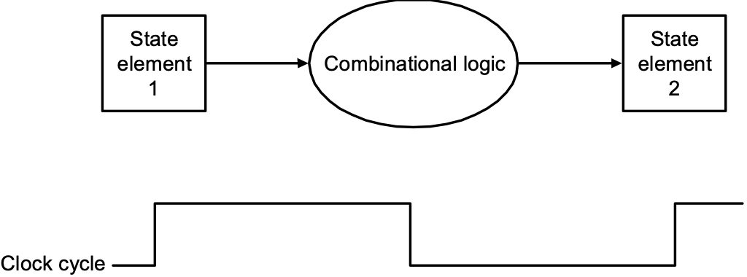
Our Implementation
An edge triggered methodology
Typical execution:
read contents of some state elements,
send values through some combinational logic
write results to one or more state elements

Slide 10
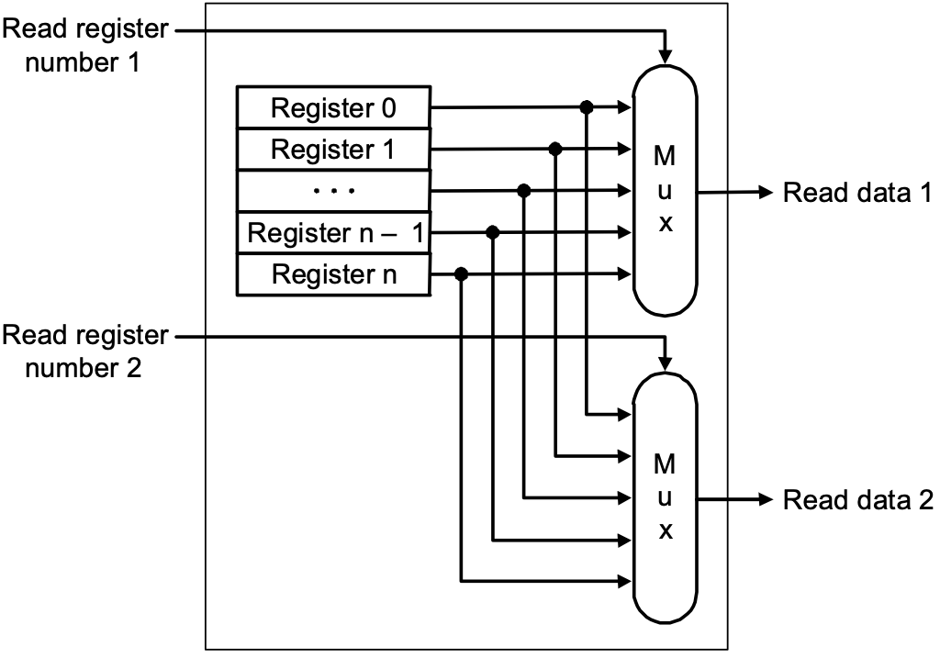
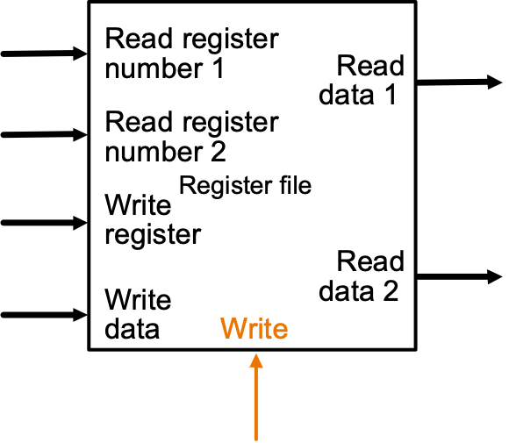
Register File
Built using D flip-flops

Slide 11
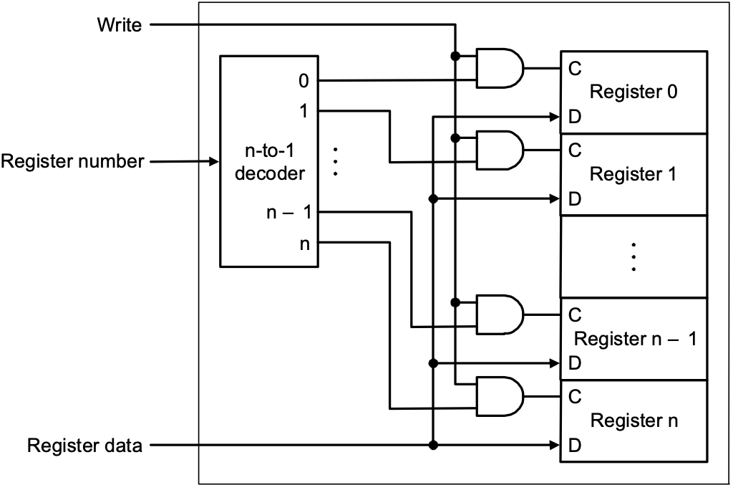
Register File
Note: we still use the real clock to determine when to write

Slide 12
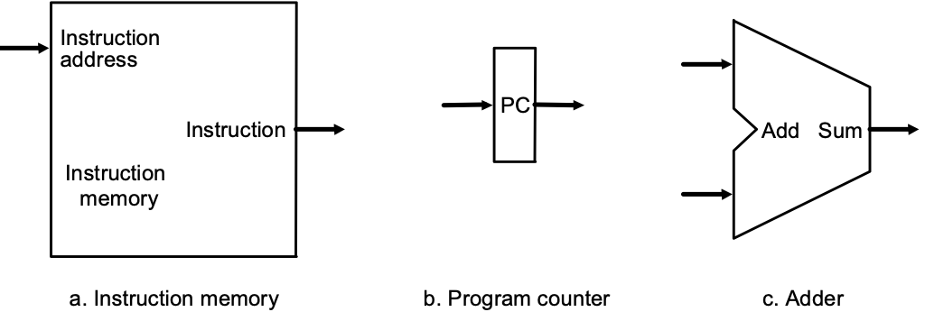
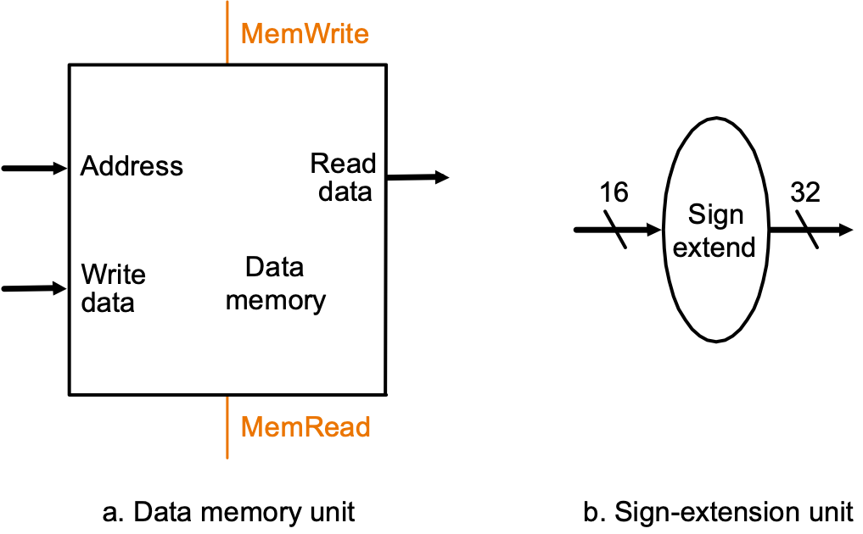
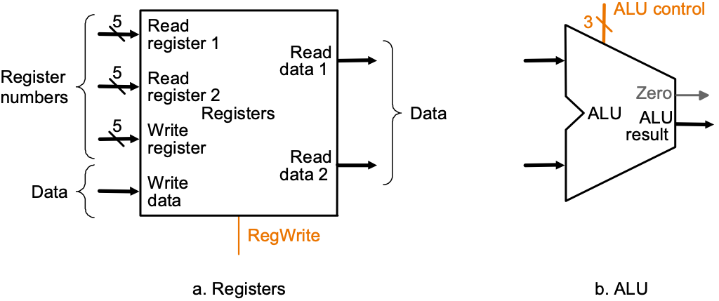
Simple Implementation
Include the functional units we need for each instruction
Why do we need this stuff?

Slide 13
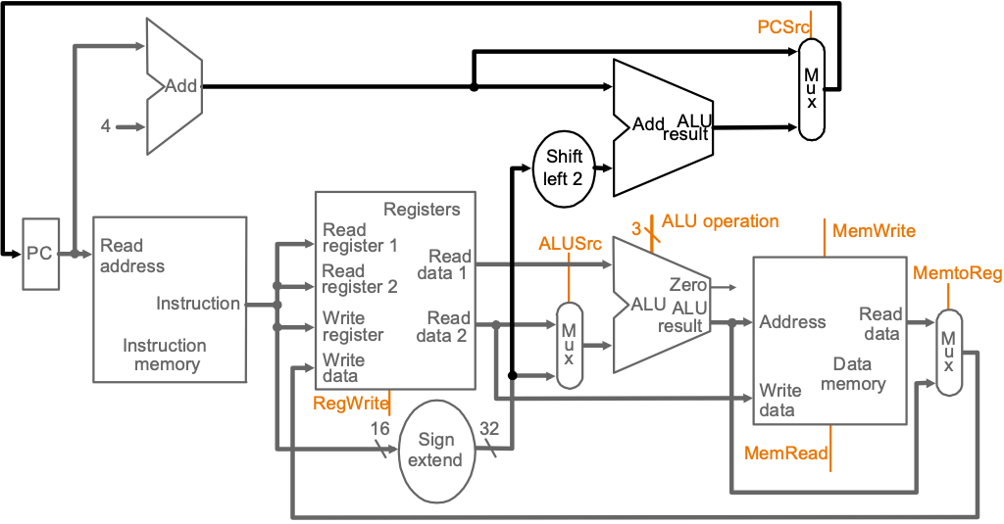
Building the Datapath
Use multiplexors to stitch them together

Slide 14
Control
Selecting the operations to perform (ALU, read/write, etc.)
Controlling the flow of data (multiplexor inputs)
Information comes from the 32 bits of the instruction
Example: add $8, $17, $18 Instruction Format:
ALU's operation based on instruction type and function code
000000
10001
10010
01000
00000
100000
op
rs
rt
rd
shamt
func

Slide 15
Control
e.g., what should the ALU do with this instruction
Example: lw $1, 100($2)
ALU control input 000 AND 001 OR 010 add 110 subtract 111 set-on-less-than
Why is the code for subtract 110 and not 011?
35
2
1
100
op
rs
rt
16

Slide 16
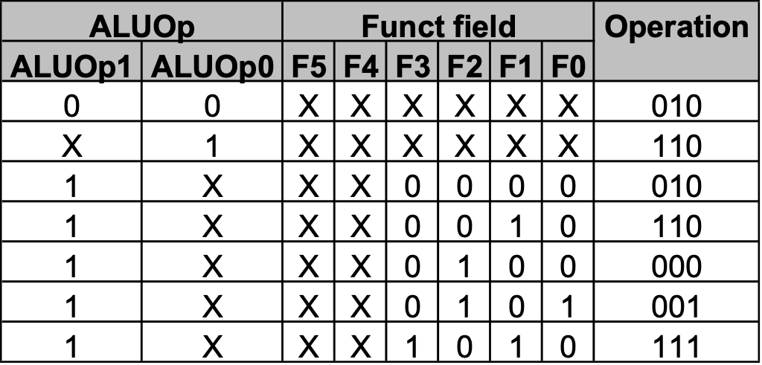
Control
Must describe hardware to compute 3-bit ALU control input
given instruction type 00 = lw, sw 01 = beq, 11 = arithmetic
function code for arithmetic
Describe it using a truth table (can turn into gates):
ALUOp
computed from instruction type

Slide 17
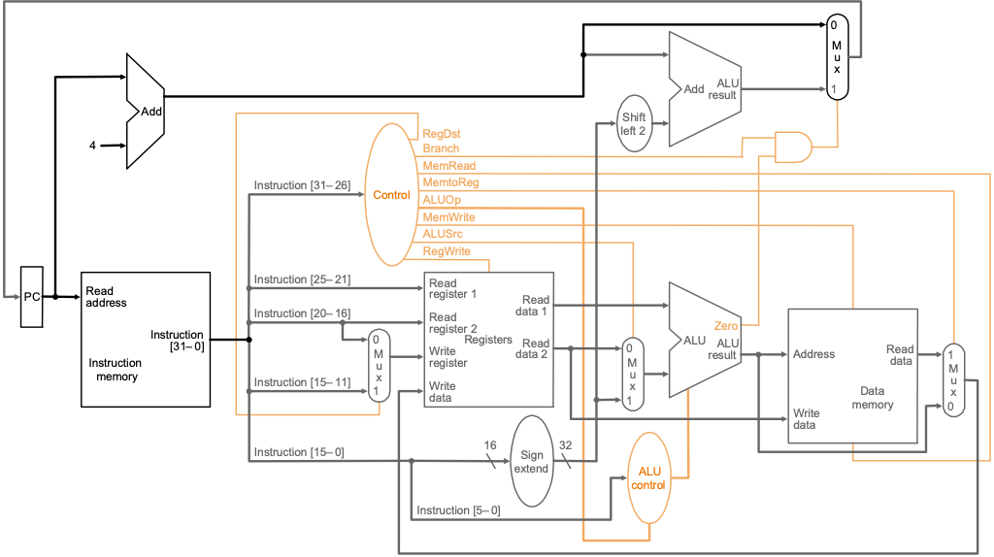
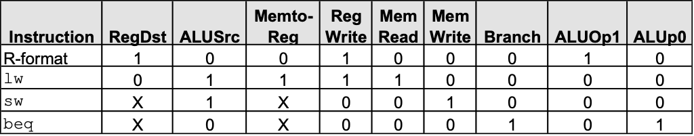
Control

Slide 18
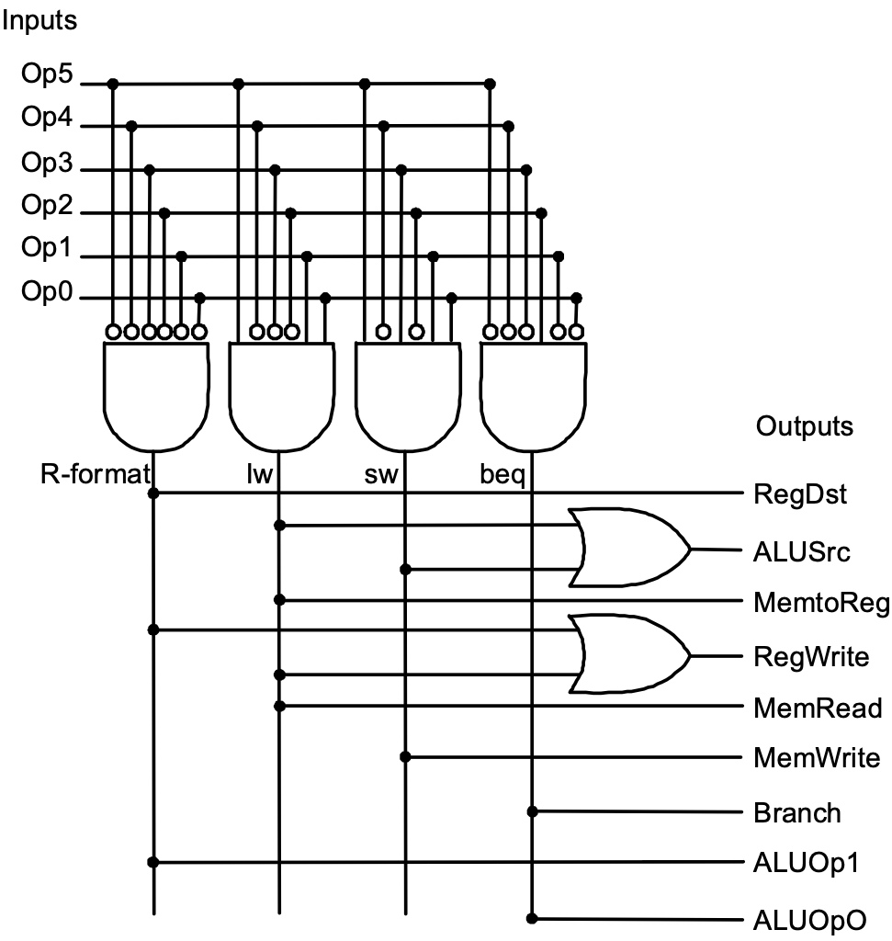
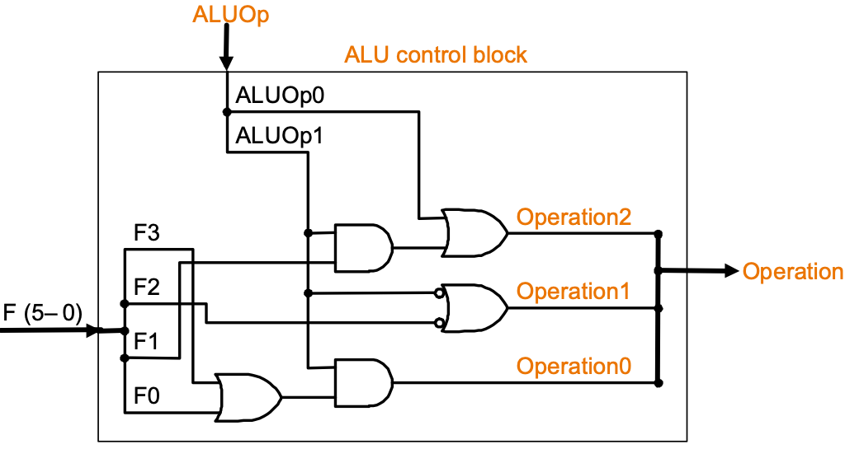
Control
Simple combinational logic (truth tables)

Slide 19
Our Simple Control Structure
All of the logic is combinational
We wait for everything to settle down, and the right thing to be done
ALU might not produce “right answer” right away
we use write signals along with clock to determine when to write
Cycle time determined by length of the longest path
We are ignoring some details like setup and hold times

Slide 20
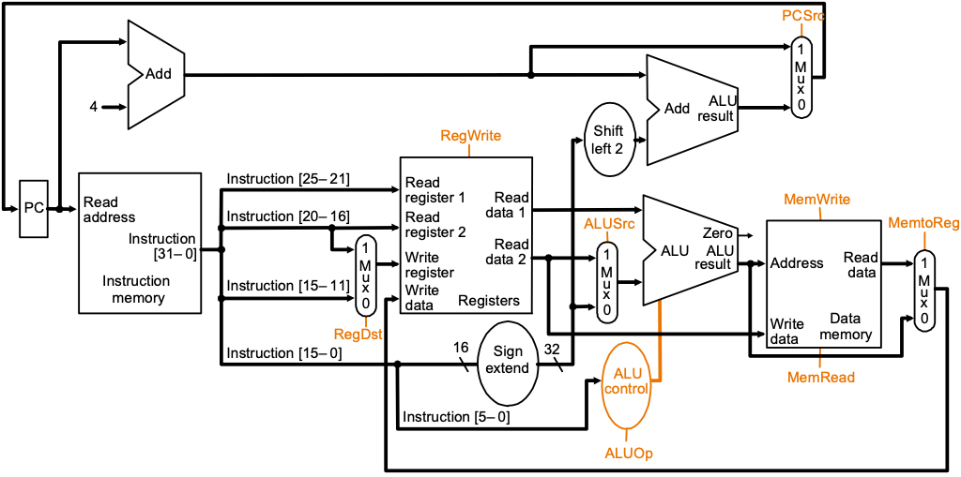
Review – R-type Instructions

Slide 21
Review – Lw Instruction

Slide 22
Review – Branch Instructions

Slide 23
Single Cycle Implementation
Calculate cycle time assuming negligible delays except:
memory (2ns), ALU and adders (2ns), register file access (1ns)

Slide 24
Single Cycle – Steps of each instruction
Inst. Type | Functional Units Used
R-type | Instruction fetch | Register read | ALU | Register write
Load | Instruction fetch | Register read | ALU | Memory access | Register write
Store | Instruction fetch | Register read | ALU | Memory access
Branch | Instruction fetch | Register read | ALU
Jump | Instruction fetch

Slide 25
Single Cycle – How long is the cycle?
Inst. Type | Inst. Mem. | Reg. File (read) | ALU (s) | Data Mem. | Reg. File (write) | Total
R-type | 2 | 1 | 2 | 0 | 1 | 6 ns
Load | 2 | 1 | 2 | 2 | 1 | 8 ns
Store | 2 | 1 | 2 | 2 | 0 | 7 ns
Branch | 2 | 1 | 2 | 0 | 0 | 5 ns
Jump | 2 | 0 | 0 | 0 | 0 | 2 ns
Inst. %
44
24
12
18
2
The cycle time must accommodate the longest operation: lw.
Cycle time = 8 ns but the CPI = 1.
If we can accommodate variable number of cycles for each instruction and a cycle time of 1ns.
CPI = 6*44% + 8*24% + 7*12% + 5*18% + 2*2% = 6.3
How much faster would this machine be?

Slide 26
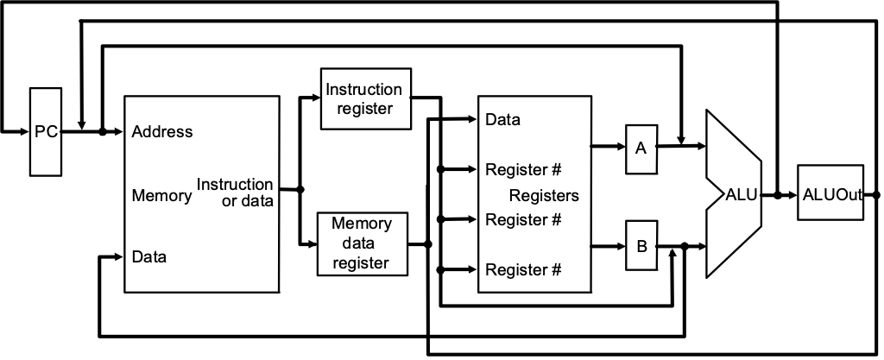
Where we are headed
Single Cycle Problems:
what if we had a more complicated instruction like floating point?
wasteful of area
One Solution:
use a “smaller” cycle time
have different instructions take different numbers of cycles
a “multicycle” datapath:

Slide 27
Multicycle Approach
We will be reusing functional units
ALU used to compute address and to increment PC
Memory used for instruction and data
Our control signals will not be determined solely by instruction
e.g., what should the ALU do for a “subtract” instruction?
We’ll use a finite state machine for control

Slide 28
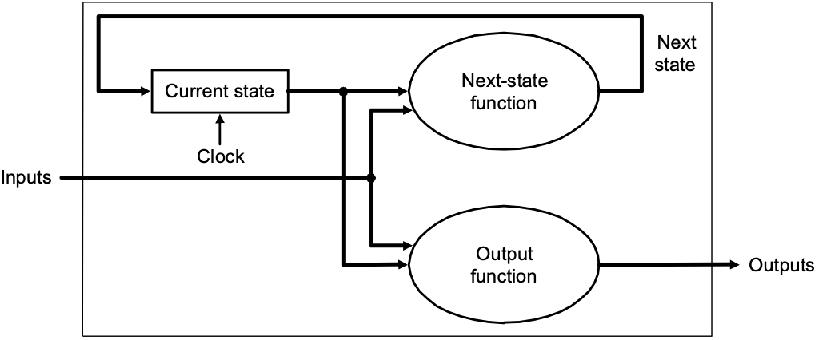
Review: finite state machines
Finite state machines:
a set of states and
next state function (determined by current state and the input)
output function (determined by current state and possibly input)
We’ll use a Moore machine (output based only on current state)

Slide 29
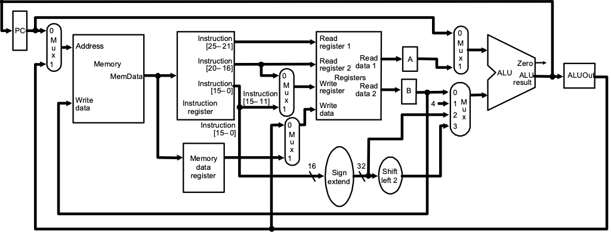
Multicycle Approach
Break up the instructions into steps, each step takes a cycle
balance the amount of work to be done
restrict each cycle to use only one major functional unit
At the end of a cycle
store values for use in later cycles (easiest thing to do)
introduce additional “internal” registers

Slide 30
Muticyle Datapath
8/9
6
7
3
10
1
4
2
11
5

Slide 31
Five Execution Steps
Instruction Fetch (F)
Instruction Decode and Register Fetch (D)
Execution, Memory Address Computation, or Branch Completion (EX)
Memory Access or R-type instruction completion (M)
Write-back step (W) INSTRUCTIONS TAKE FROM 3 - 5 CYCLES!

Slide 32
Step 1: Instruction Fetch
Use PC to get instruction and put it in the Instruction Register.
Increment the PC by 4 and put the result back in the PC.
Can be described succinctly using RTL "Register-Transfer Language" IR = Memory[PC]; PC = PC + 4; Can we figure out the values of the control signals? What is the advantage of updating the PC now?

Slide 33
Step 2: Instruction Decode and Register Fetch
Read registers rs and rt in case we need them
Compute the branch address in case the instruction is a branch
RTL: A = Reg[IR[25-21]]; B = Reg[IR[20-16]]; ALUOut = PC + (sign-extend(IR[15-0]) << 2);
We aren't setting any control lines based on the instruction type (we are busy "decoding" it in our control logic)

Slide 34
Step 3 (instruction dependent)
ALU is performing one of three functions, based on instruction type
Memory Reference: ALUOut = A + sign-extend(IR[15-0]);
R-type: ALUOut = A op B;
Branch: if (A==B) PC = ALUOut;

Slide 35
Step 4 (R-type or memory-access)
Loads and stores access memory MDR = Memory[ALUOut]; or Memory[ALUOut] = B;
R-type instructions finish Reg[IR[15-11]] = ALUOut; The write actually takes place at the end of the cycle on the edge

Slide 36
Step 5 Write-back step
Reg[IR[20-16]]= MDR;
What about all the other instructions?

Slide 37
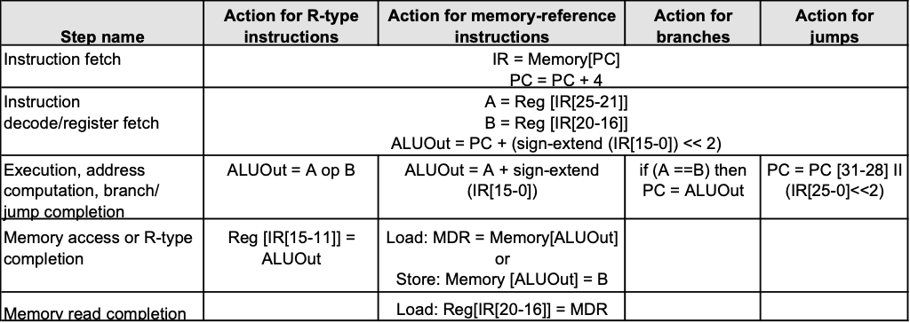
Summary:

Slide 38
Simple Questions
How many cycles will it take to execute this code? lw $t2, 0($t3) lw $t3, 4($t3) beq $t2, $t3, Label #assume not add $t5, $t2, $t3 sw $t5, 8($t3) Label: ...
What is going on during the 8th cycle of execution?
In what cycle does the actual addition of $t2 and $t3 takes place?

Slide 39
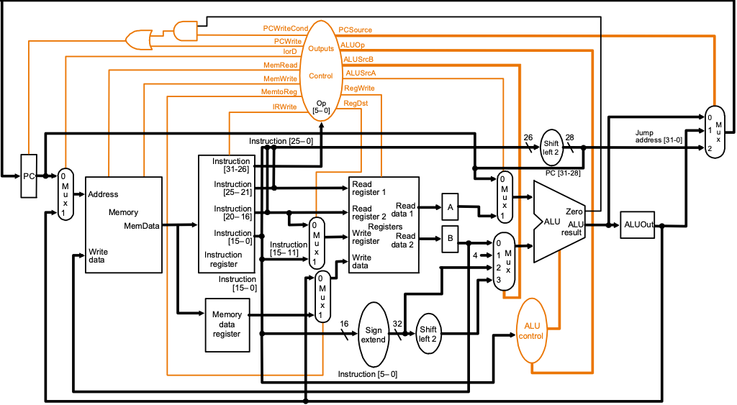
Datapath of Multicycle Implementation

Slide 40
Implementing the Control
Value of control signals is dependent upon:
what instruction is being executed
which step is being performed
Use the information we’ve accumulated to specify a finite state machine
specify the finite state machine graphically, or
use microprogramming
Implementation can be derived from specification

Slide 41
Graphical Specification of FSM
0
Instruction
Fetch
1
Instruction
Decode
Start
Op = LW or SW
Op = R-type
Op = BEQ
Op = J
2
Mem. Address
Compute
6
ALU
Execute
8
Complete
Branch
9
Complete
Jump
Op = SW
Op = LW
3
Mem. Access
Read
5
Mem. Access
Write
7
Complete
R-type
4
Write-Back
How many state bits will we need?

Slide 42
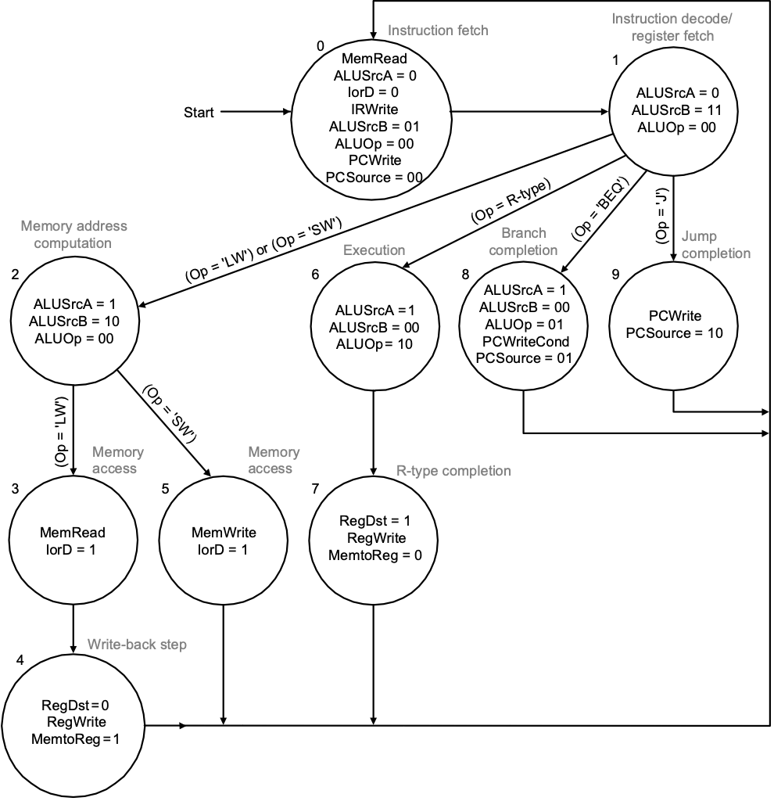
Detailed FSM

Slide 43
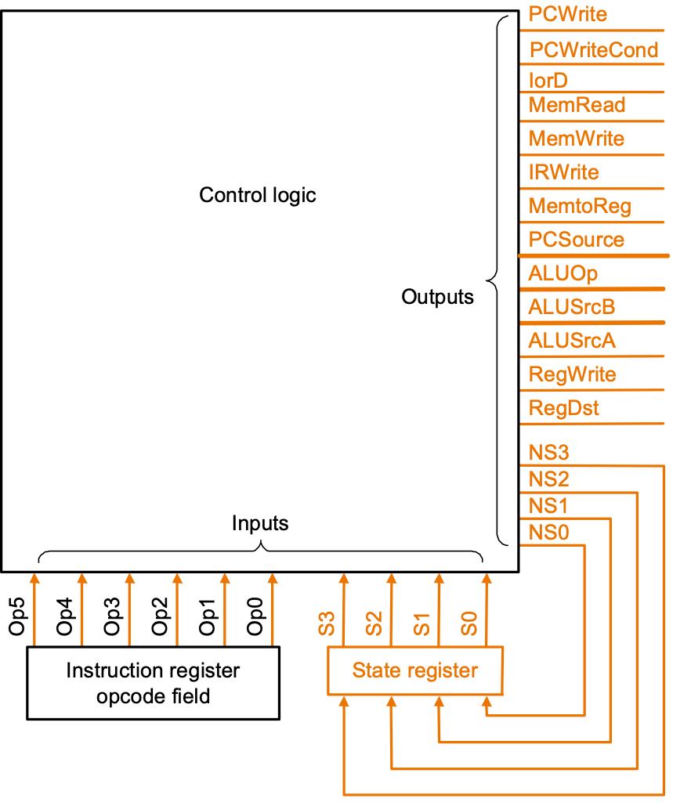
Finite State Machine for Control
Implementation:

Slide 44
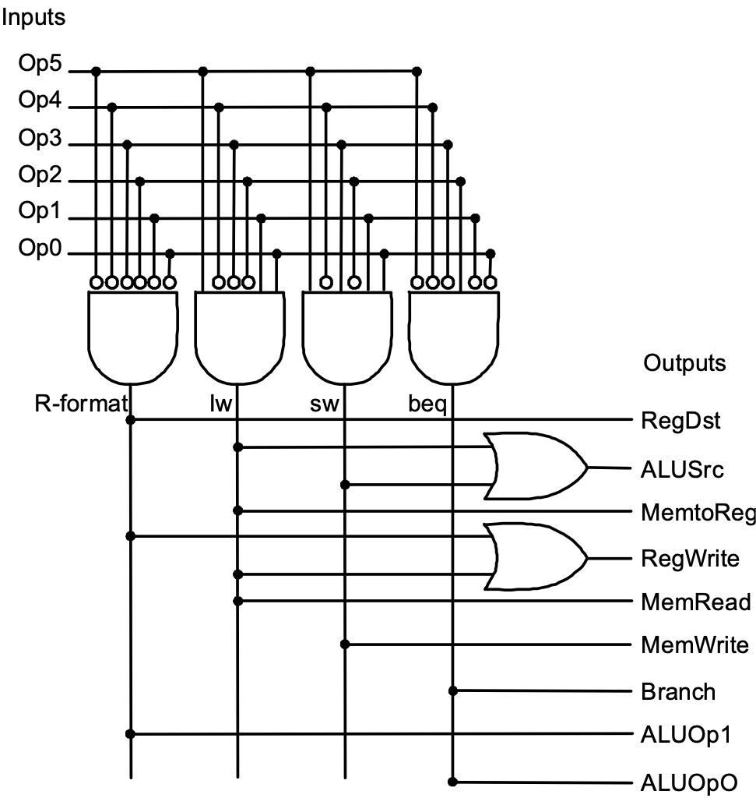

Slide 45
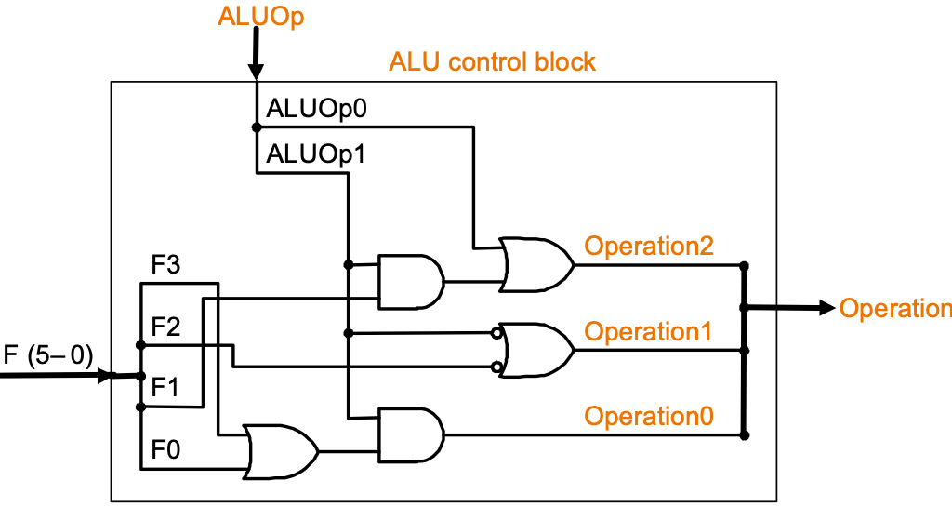

Slide 46
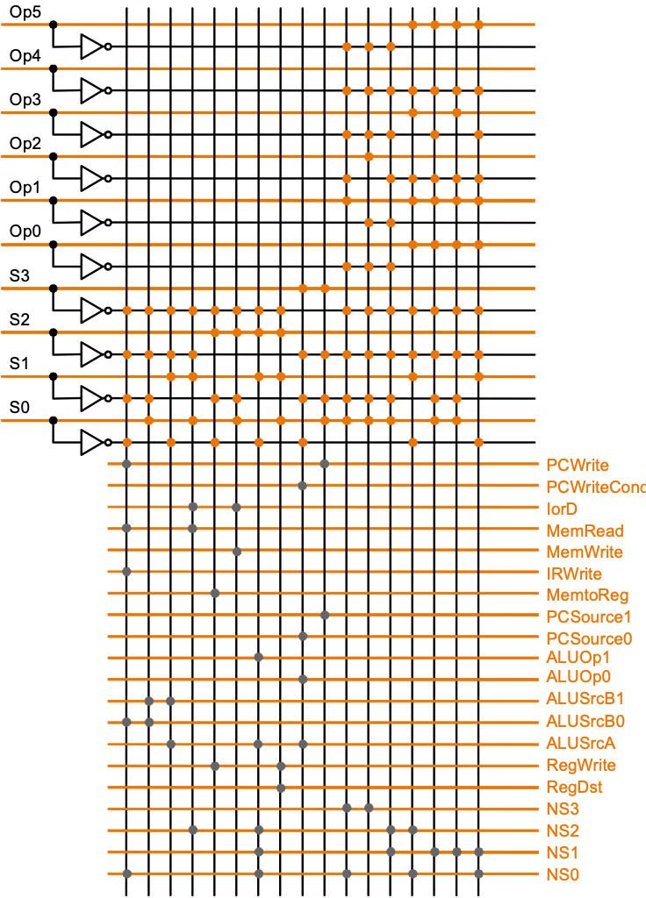
PLA Implementation
If I picked a horizontal or vertical line could you explain it?

Slide 47
ROM Implementation
ROM = "Read Only Memory"
values of memory locations are fixed ahead of time
A ROM can be used to implement a truth table
if the address is m-bits, we can address 2^{m} entries in the ROM.
our outputs are the bits of data that the address points to. m is the "heigth", and n is the "width"
0 0 0 0 0 1 1
0 0 1 1 1 0 0
0 1 0 1 1 0 0
0 1 1 1 0 0 0
1 0 0 0 0 0 0
1 0 1 0 0 0 1
1 1 0 0 1 1 0
1 1 1 0 1 1 1
m
n

Slide 48
ROM Implementation
How many inputs are there? 6 bits for opcode, 4 bits for state = 10 address lines (i.e., 2¹⁰ = 1024 different addresses)
How many outputs are there? 16 datapath-control outputs, 4 state bits = 20 outputs
ROM is 2¹⁰ x 20 = 20K bits
Rather wasteful, since for lots of the entries, the outputs are the same — i.e., opcode is often ignored

Slide 49
ROM vs PLA
Break up the table into two parts — 4 state bits tell you the 16 outputs, 2⁴ x 16 bits of ROM — 10 bits tell you the 4 next state bits, 2¹⁰ x 4 bits of ROM — Total: 4.3K bits of ROM
PLA is much smaller — can share product terms — only need entries that produce an active output — can take into account don't cares
Size is (#inputs × #product-terms) + (#outputs × #product-terms) For this example = (10x17)+(20x17) = 460 PLA cells
PLA cells usually about the size of a ROM cell (slightly bigger)

Slide 50
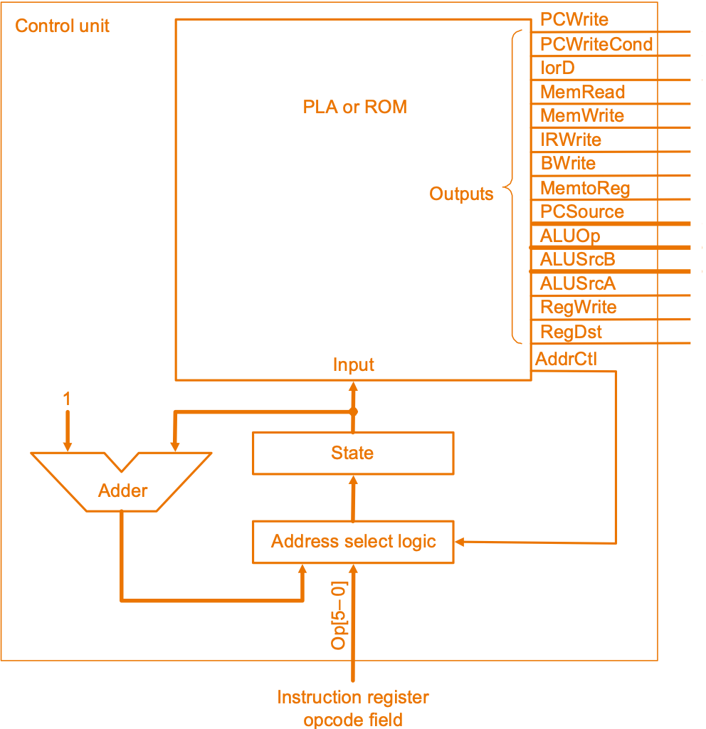
Another Implementation Style
Complex instructions: the "next state" is often current state + 1

Slide 51
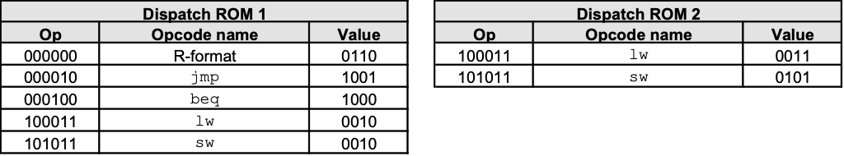
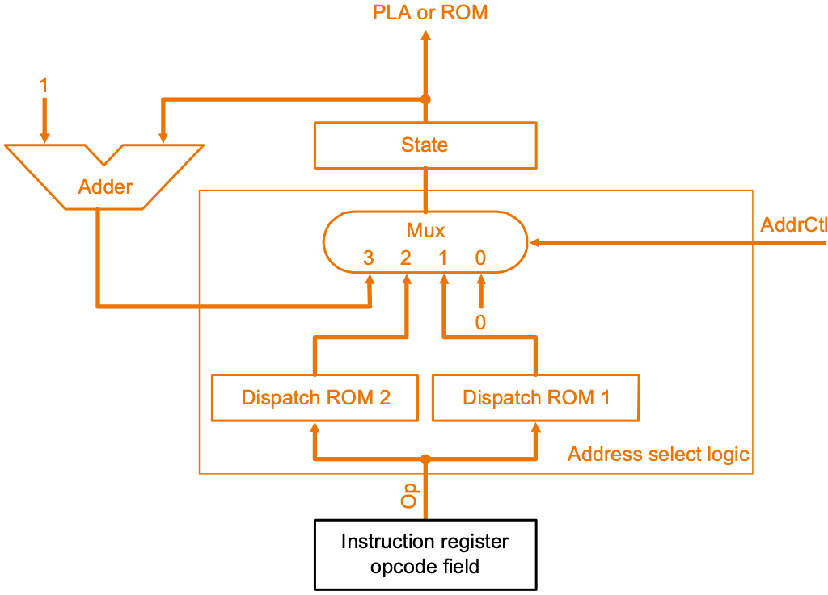
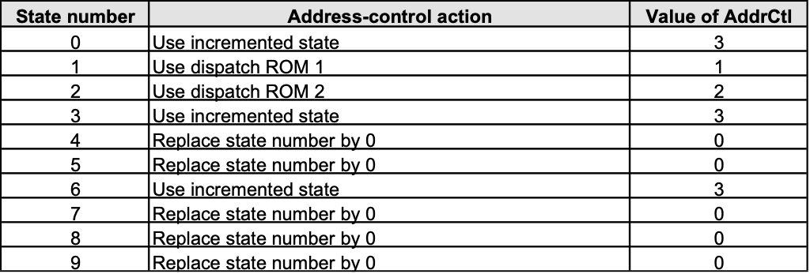
Details

Slide 52
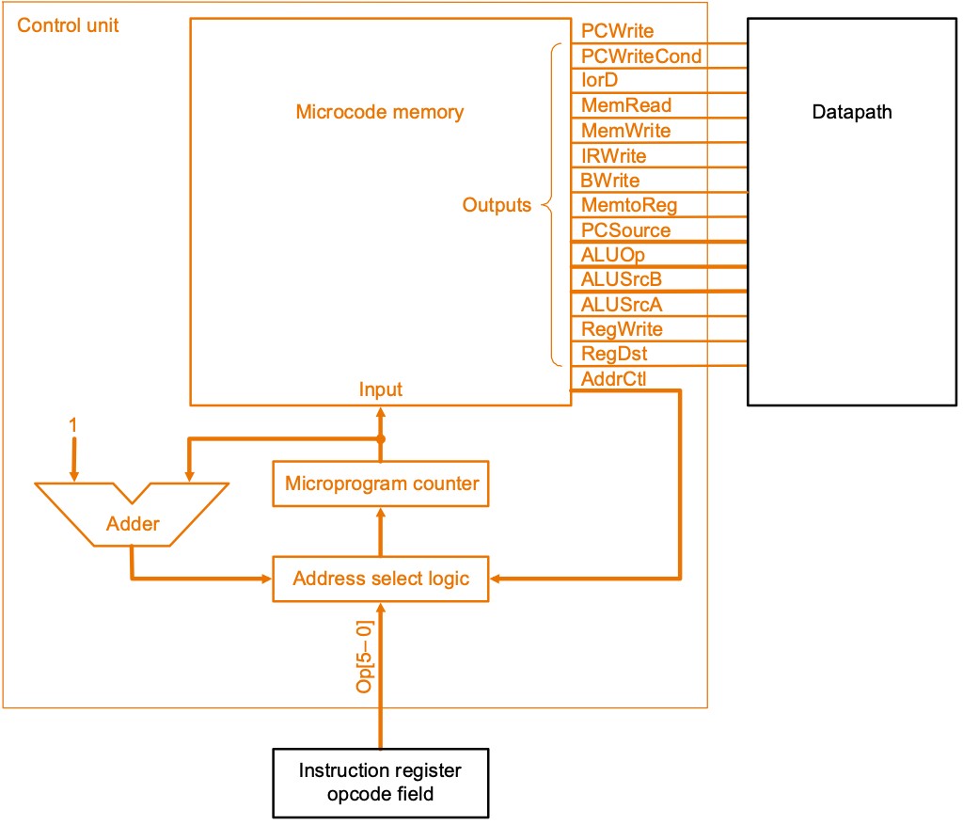
Microprogramming
What are the “microinstructions” ?

Slide 53
Microprogramming
How all CISC ISAs were built.
μ-store: RAM-memory with N bits/word
N = number of control lines in CPU.
Execution of each instruction starts IF and ID.
Instruction Opcode points to a location in μ-store
Output consecutive control words until DONE.
μ-store is updatable
μ-controller is = a mini-CPU running the main CPU
Μ-programming worked when CPU = multiple boards
μ-controller on one board: much faster

Slide 54
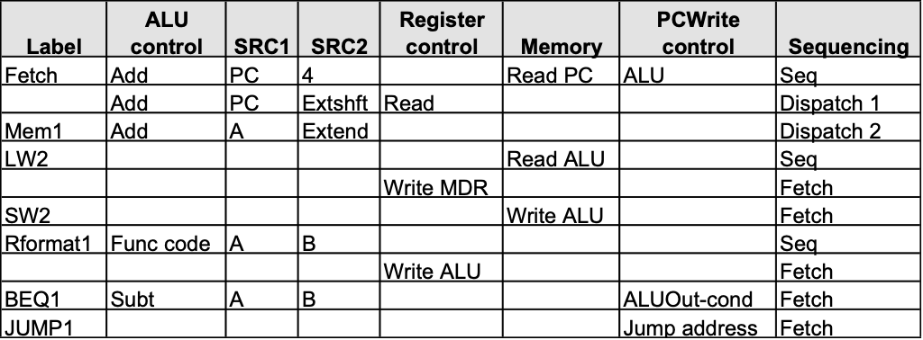
Microprogramming
A specification methodology
appropriate if hundreds of opcodes, modes, cycles, etc.
signals specified symbolically using microinstructions
Will two implementations of the same architecture have the same microcode?
What would a microassembler do?

Slide 55
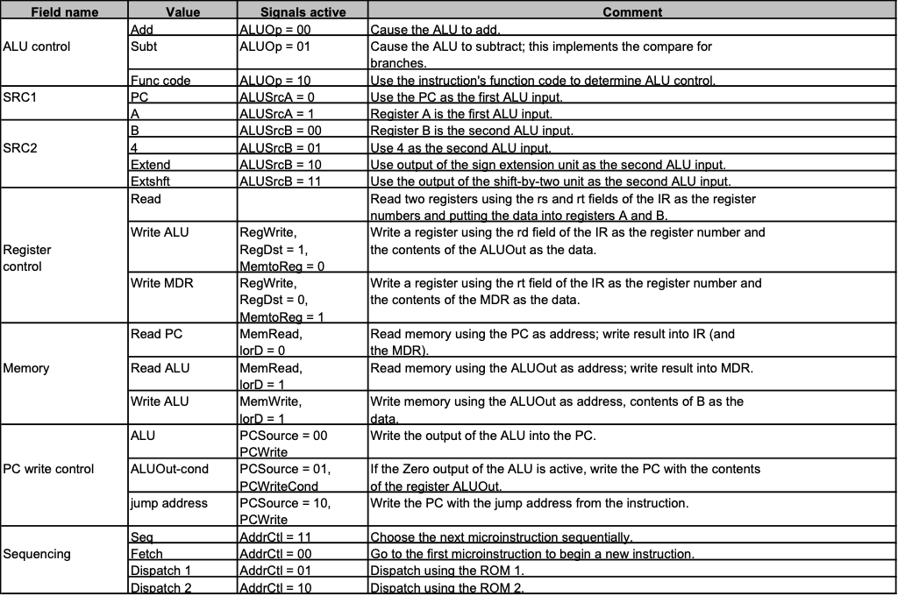
Microinstruction format

Slide 56
Maximally vs. Minimally Encoded
No encoding:
1 bit for each datapath operation
faster, requires more memory (logic)
used for Vax 780 — an astonishing 400K of memory!
Lots of encoding:
send the microinstructions through logic to get control signals
uses less memory, slower
Historical context of CISC:
Too much logic to put on a single chip with everything else
Use a ROM (or even RAM) to hold the microcode
It’s easy to add new instructions

Slide 57
Microcode: Trade-offs
Distinction between specification and implementation is sometimes blurred
Specification Advantages:
Easy to design and write
Design architecture and microcode in parallel
Implementation (off-chip ROM) Advantages
Easy to change since values are in memory
Can emulate other architectures
Can make use of internal registers
Implementation Disadvantages, SLOWER now that:
Control is implemented on same chip as processor
ROM is no longer faster than RAM
No need to go back and make changes

Slide 58
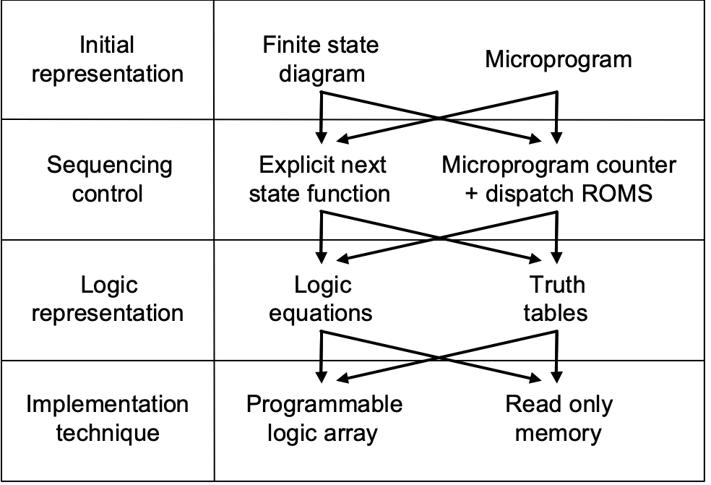
The Big Picture

